Slide 1
Spotify direct manager
Embedded software for the iot

Slide 2
Introduction

Slide 3
Problem Statement
Introduction
Our main goal was to build a system that could manage our Spotify client remotely.
Another key idea was to have some keyword spotting system to better manage our client

Slide 4
Challenges
Introduction
Making the Spotify API usable with C
Enable internet access (first through the CC3100, then with ESP32)
Establish a communication protocol between the MSP and the ESP32
Training a model to recognize sounds
Integrating our ML model in our project

Slide 5
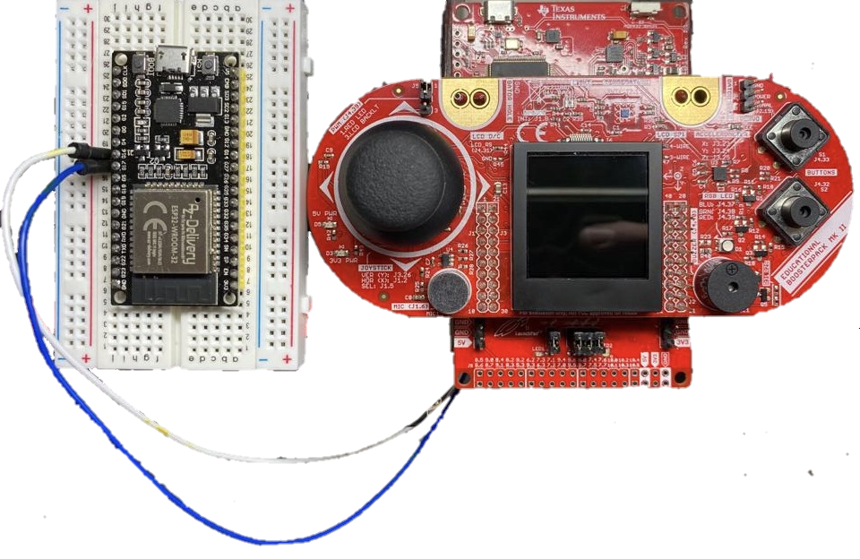
Hardware
Introduction
MSP432P401R Launchpad
MSP432P401R BoosterPackMKII
ESP32
USB cable
Jumpers

Slide 6
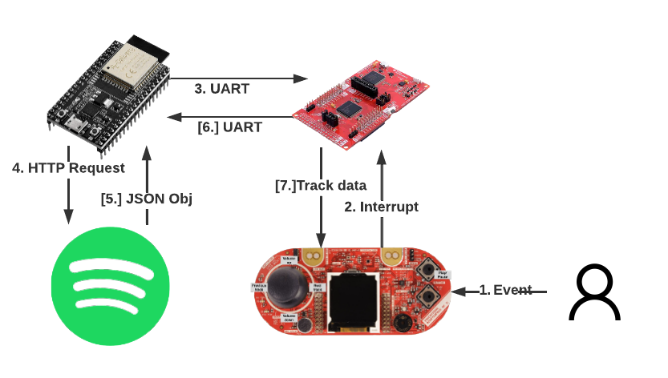
System

Slide 7
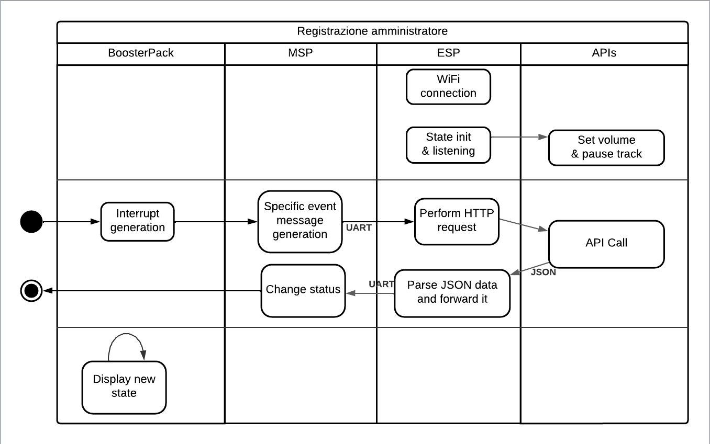

Interrupt handling
development
Init phase
Periodic

Slide 8
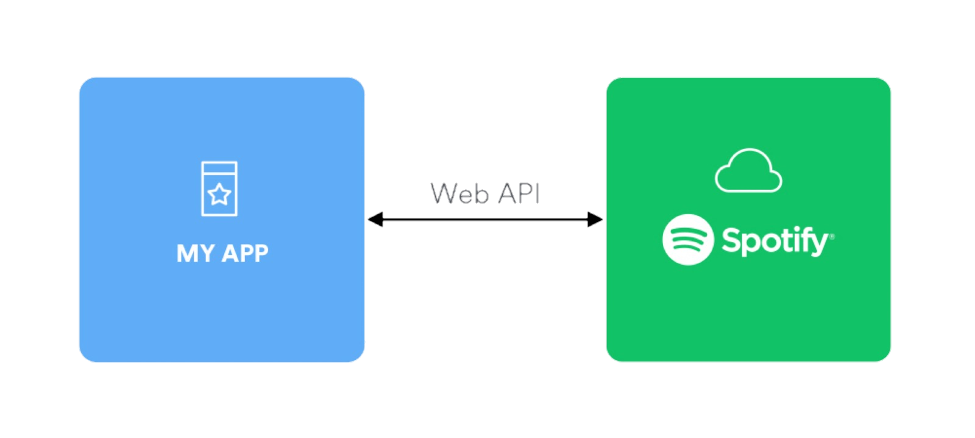
Spotify Apis side
Api access
Spotify Dev
Getting session token
HTTP to use the APIs
Parsing JSON responses

Slide 9
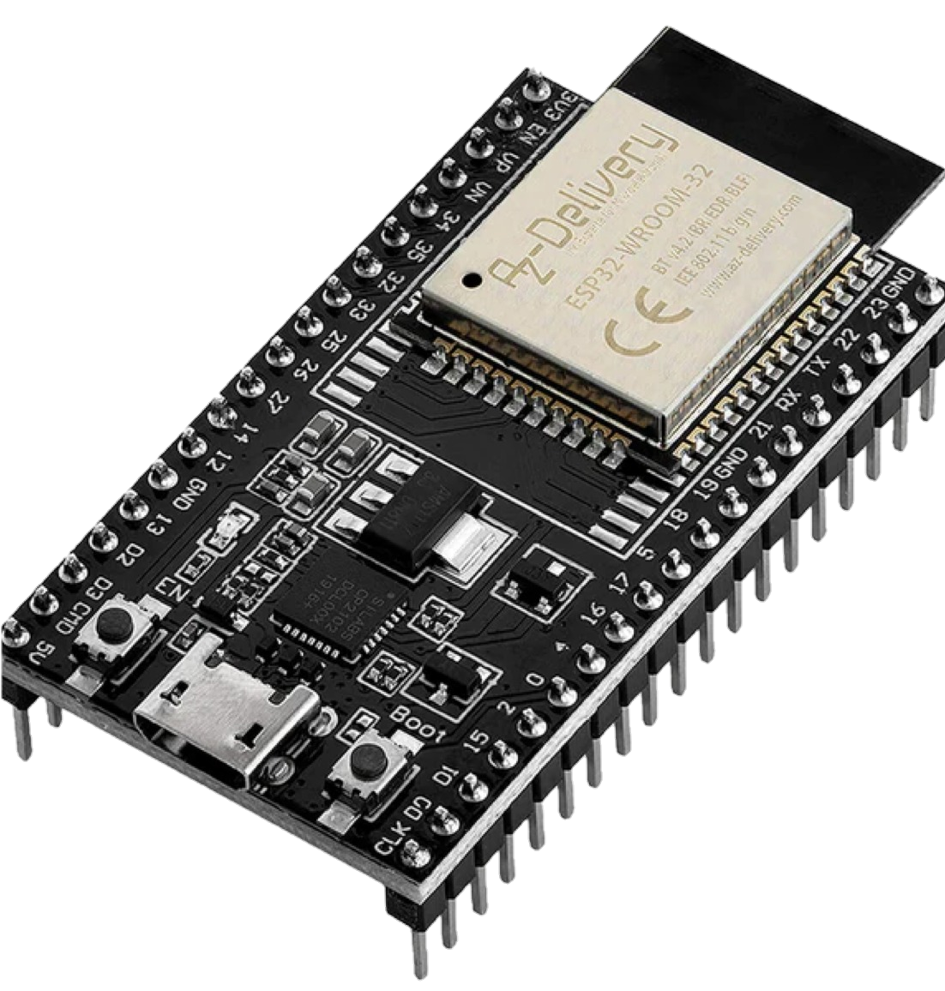
ESP Development
Development
Connecting to WiFi
Making HTTP requests to use Spotify APIs
Parse and filter JSON responses
Sending data through UART to MSP

Slide 10
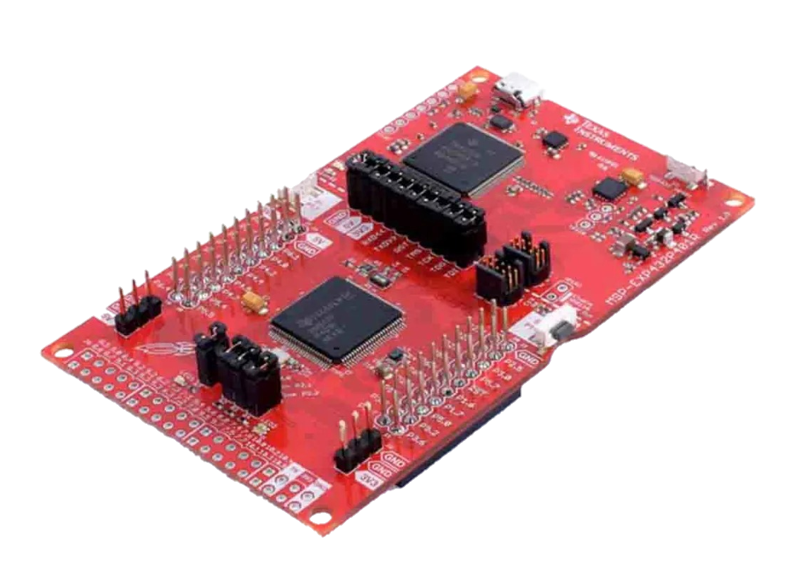
msp development
Development
Setting up interrupts with ADC
2-axis joystick
User push buttons
3-axis accelerometer (only Z)
Color TFT LCD
Getting data parsed by ESP
Designing "UI" on LCD screen
Getting APIs response
Finished!

Slide 11

or so we thought...
development
Defining an actual UART protocol
LSB vs MSB dilemma
Making UART work with LCD screen

Slide 12
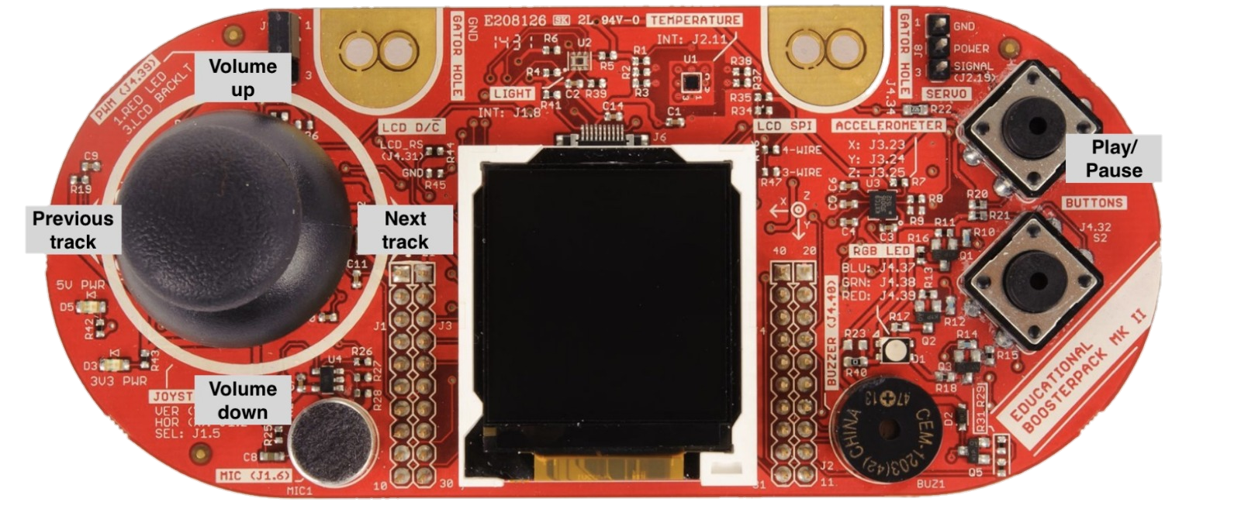
actions
Features
5 actions can be performed :
Volume Up/Down with joystick Y axis and accelerometer Z axis
Next/Previous song with joystick X axis
Play/Pause with Button
Display
Currently playing artist and song name
Dynamic volume bar visibility
Spinning logo!

Slide 13
The ml failure

Slide 14
The ml model roadmap
Issues
Getting the keyword dataset
Implementing SVM
Low accuracy on SVM (17%)
Development of CNN using EdgeImpulse
Test and integration with project
Not implemented on our project...

Slide 15
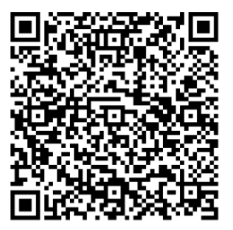
but can be tested here!
ML

Slide 16
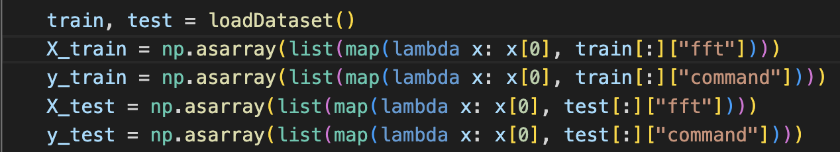
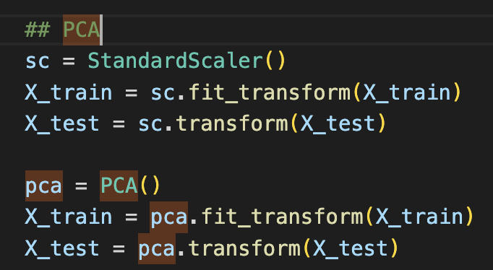
CODE
Load dataset and spilt it into training and test data
Principal Component Analysis

Slide 17
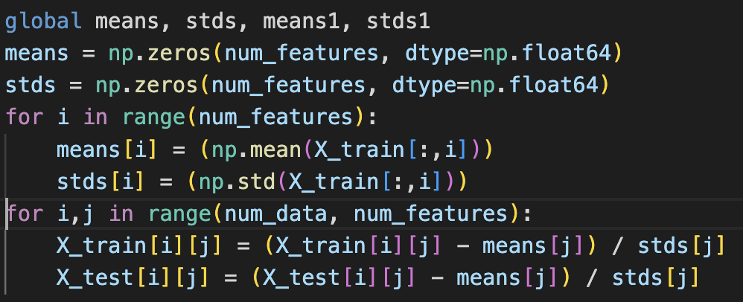
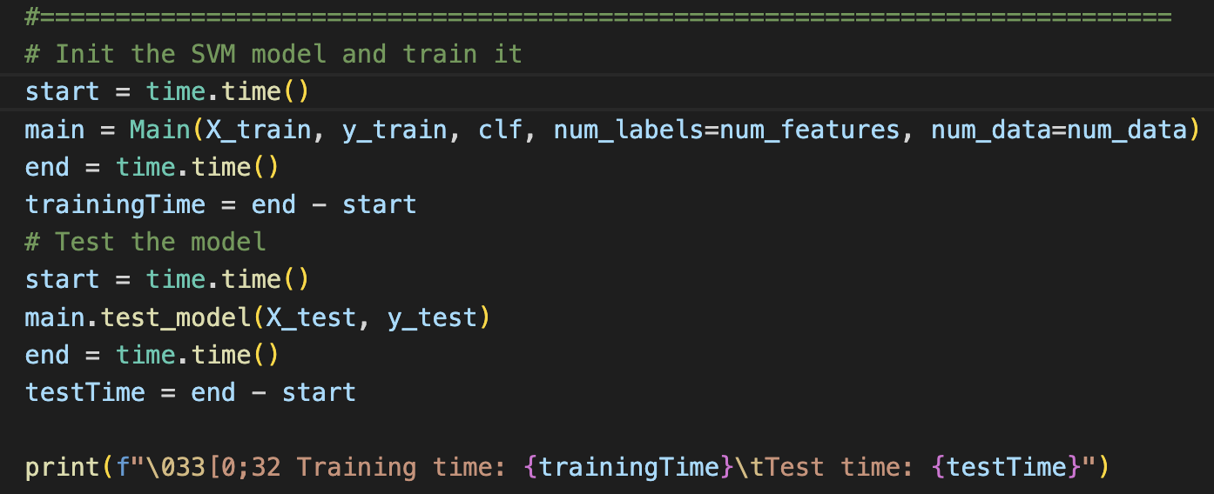
CODE
Work out mean and standard deviation to normalise data
Call SVM classifier

Slide 18
Last remarks

